Slide 1
9 Strategies For Increasing Attendance At Your Event
Timothy Bishop
Baker County Tourism – Basecamp Baker

Slide 2
1 Maintain your online presence year round
Website, Facebook, whatever you have
Update dates, confirmed sponsors , confirmed performers, registration opens, tickets go on sale, talk about what your sponsors or participants are doing throughout the year
Use sponsor, performer, and participants content ie, video of the band that's coming

Slide 3
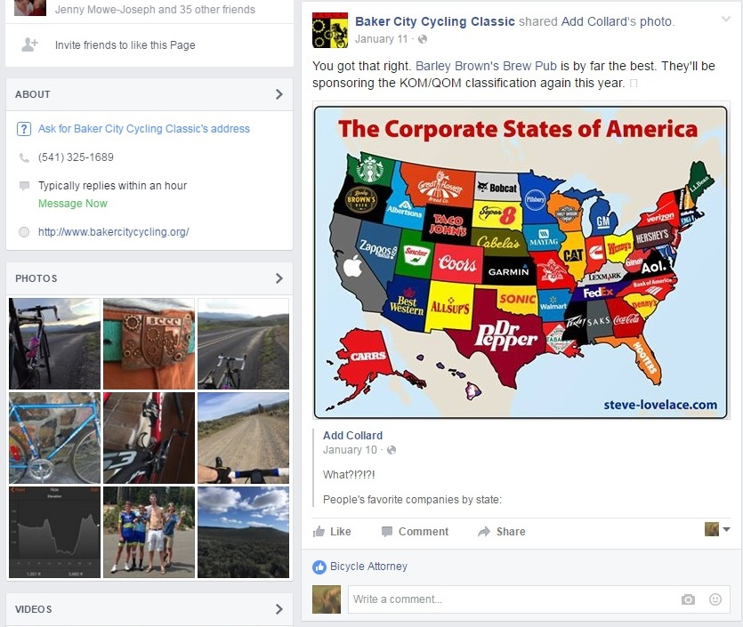

Slide 4
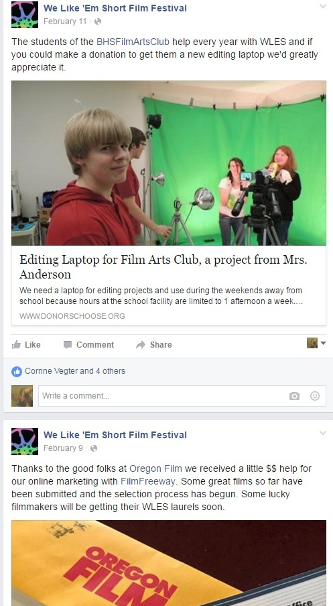

Slide 5
2 Photos, photos, and more photos
Take lots of photos. Crowds, sponsors, entertainment etc..
Use hash tags to solicit photos from others
Tag photos, your organization, your event, sponsors, partner organizations, location, etc...

Slide 6
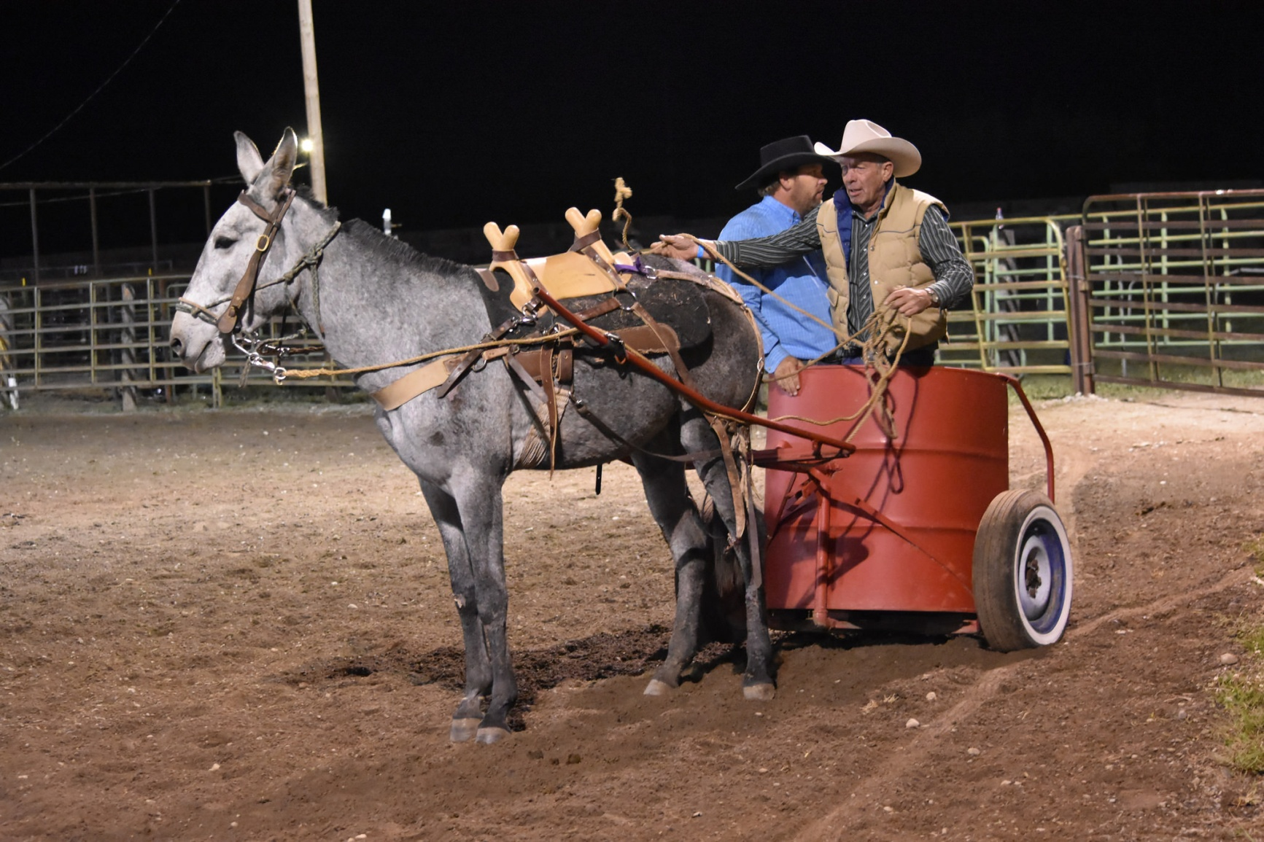
What makes your event unique?

Slide 7
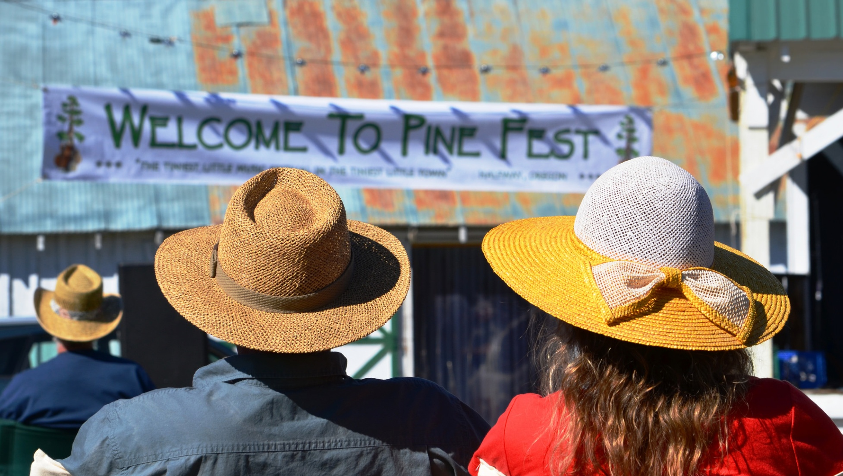
Photos that self identify your event

Slide 8
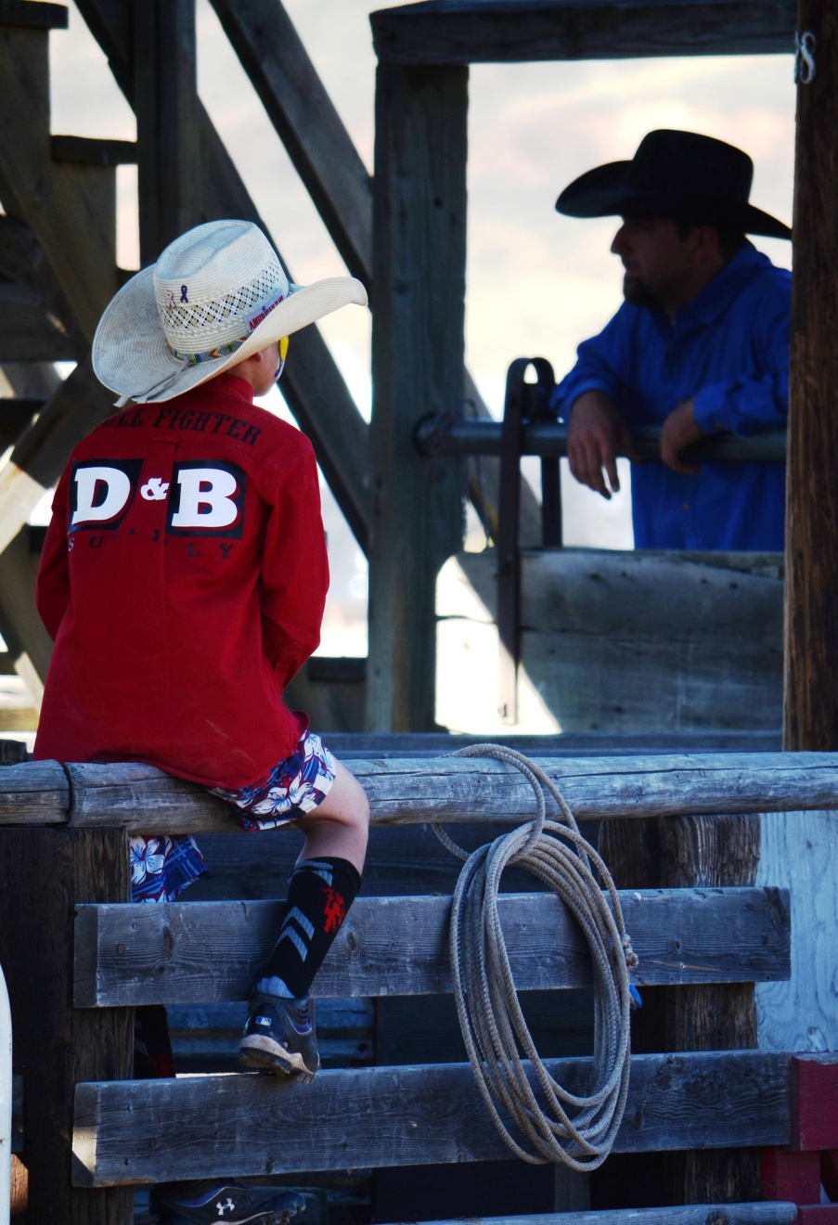
Sponsors

Slide 9
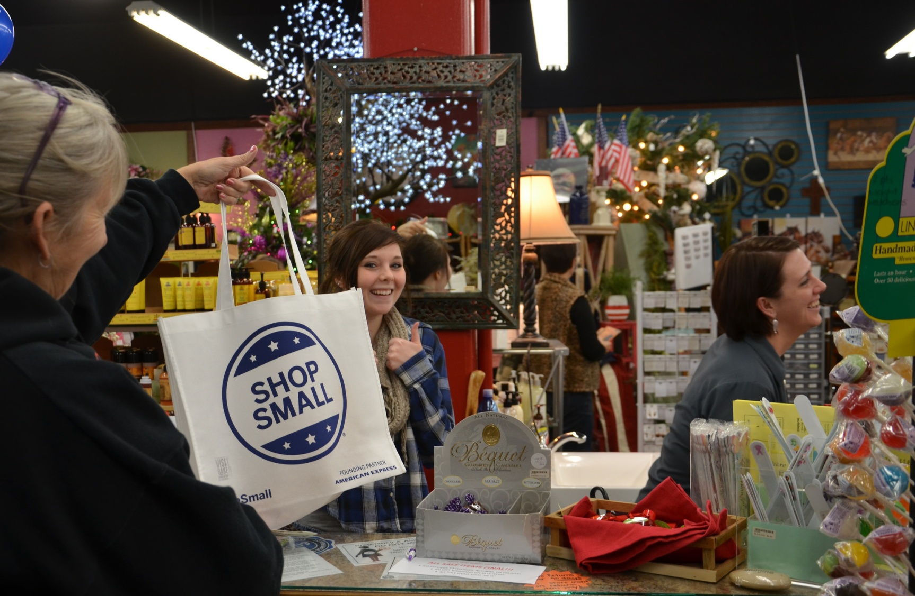
Create opportunities to share and tag

Slide 10
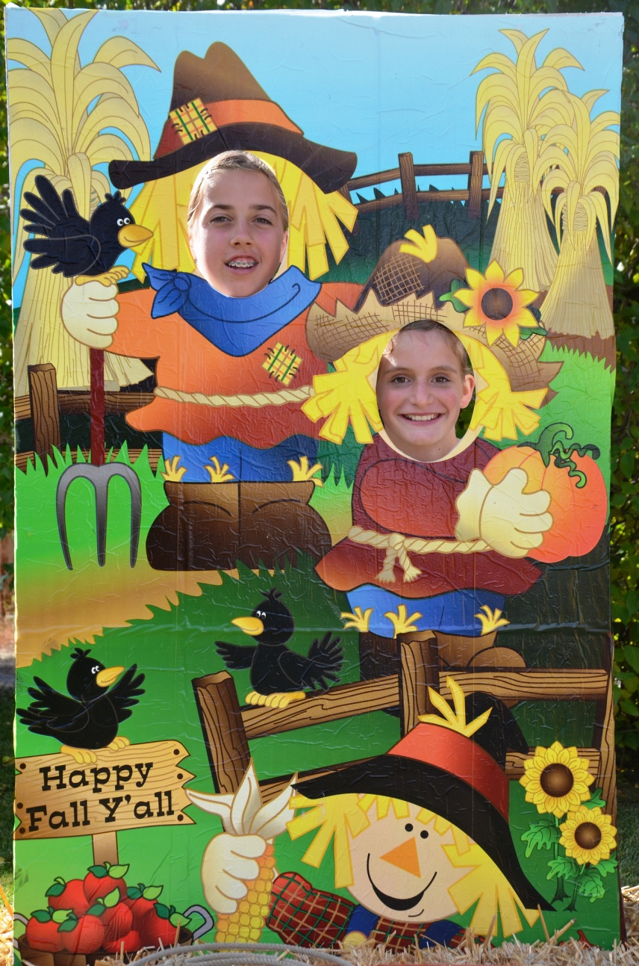
The selfie station, or photo booth

Slide 11


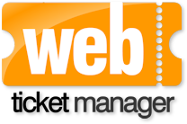


3 Online ticket sales
If you sell tickets have them available online
Registrations too

Slide 12
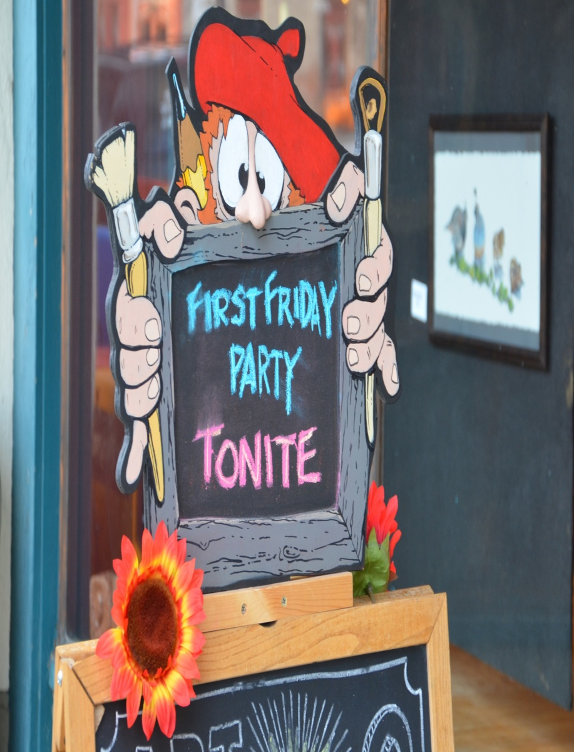
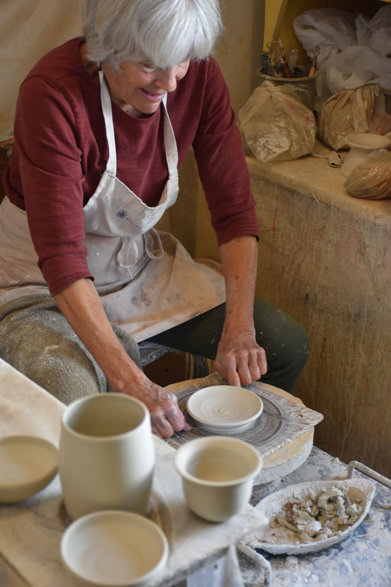
4 Coordinate with other local events to cross promote and increase market draw

Slide 13
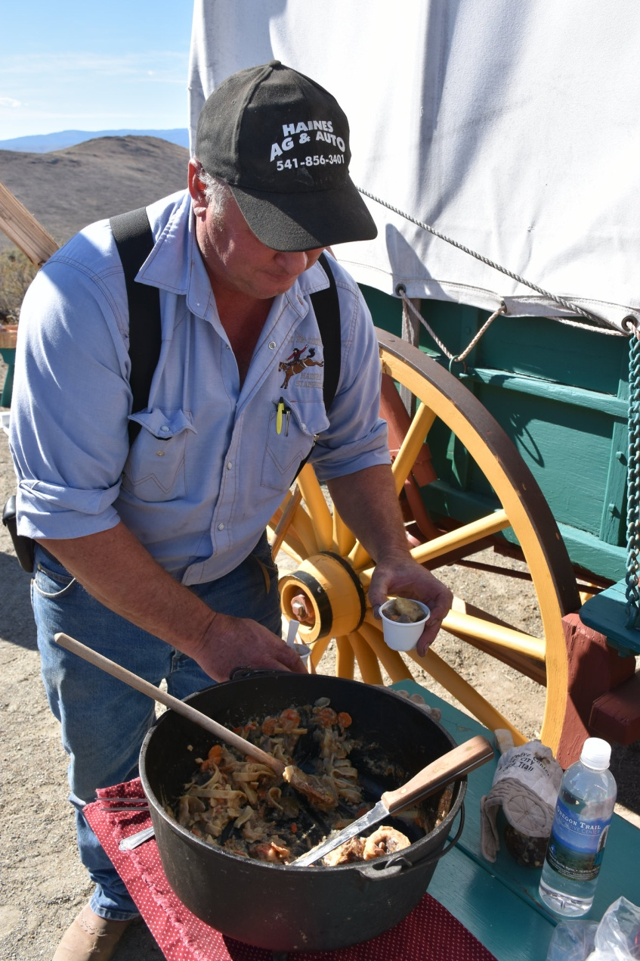
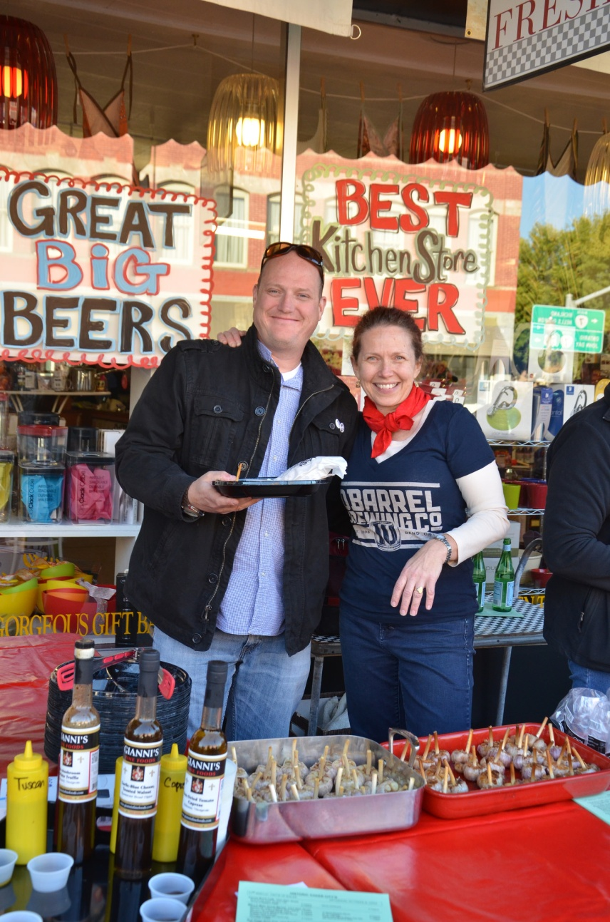
From 1 day event to 3 day getaway

Slide 14
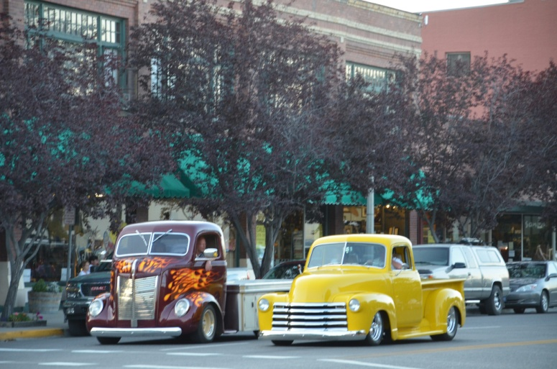
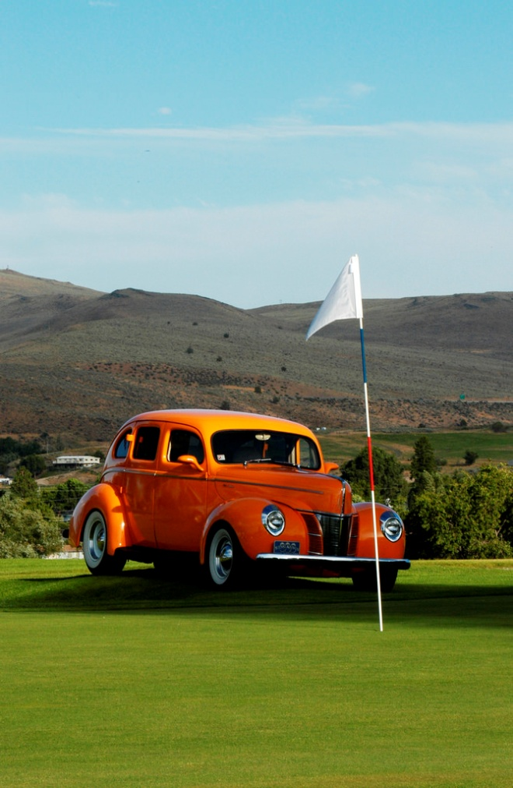
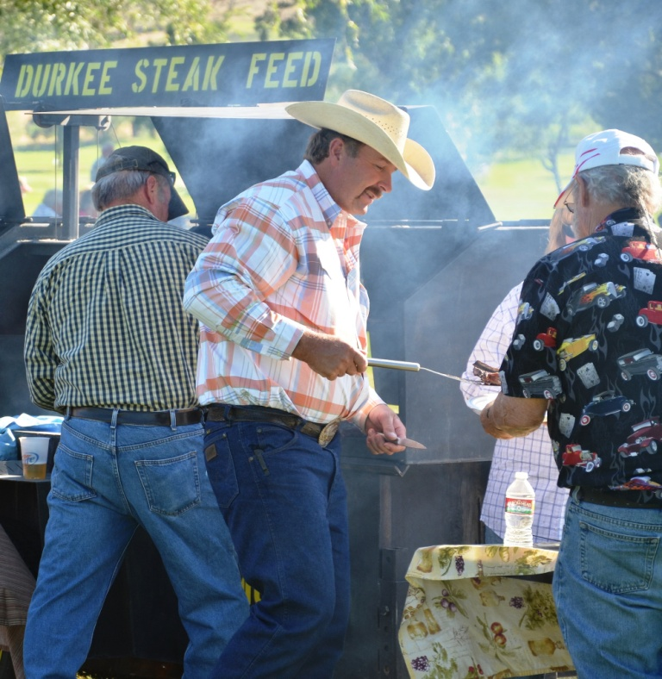
Each event or partner adds value

Slide 15
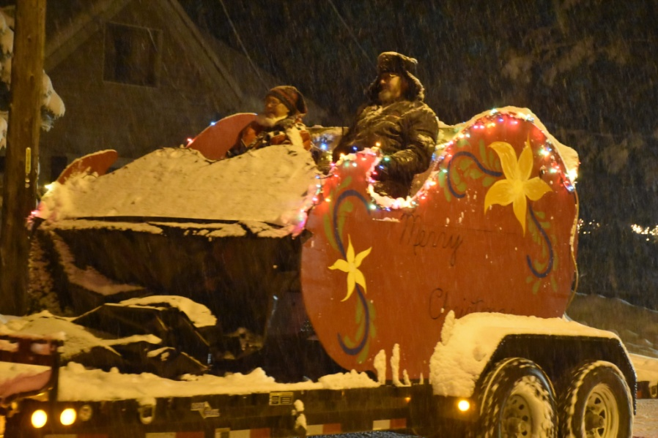
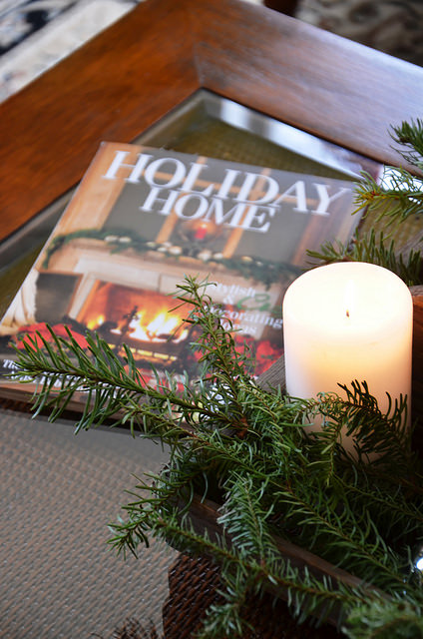
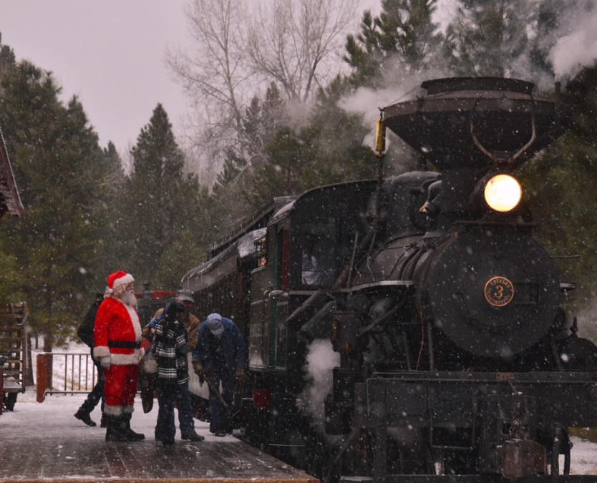
Multiple nearby events can draw attendance from a larger distance

Slide 16
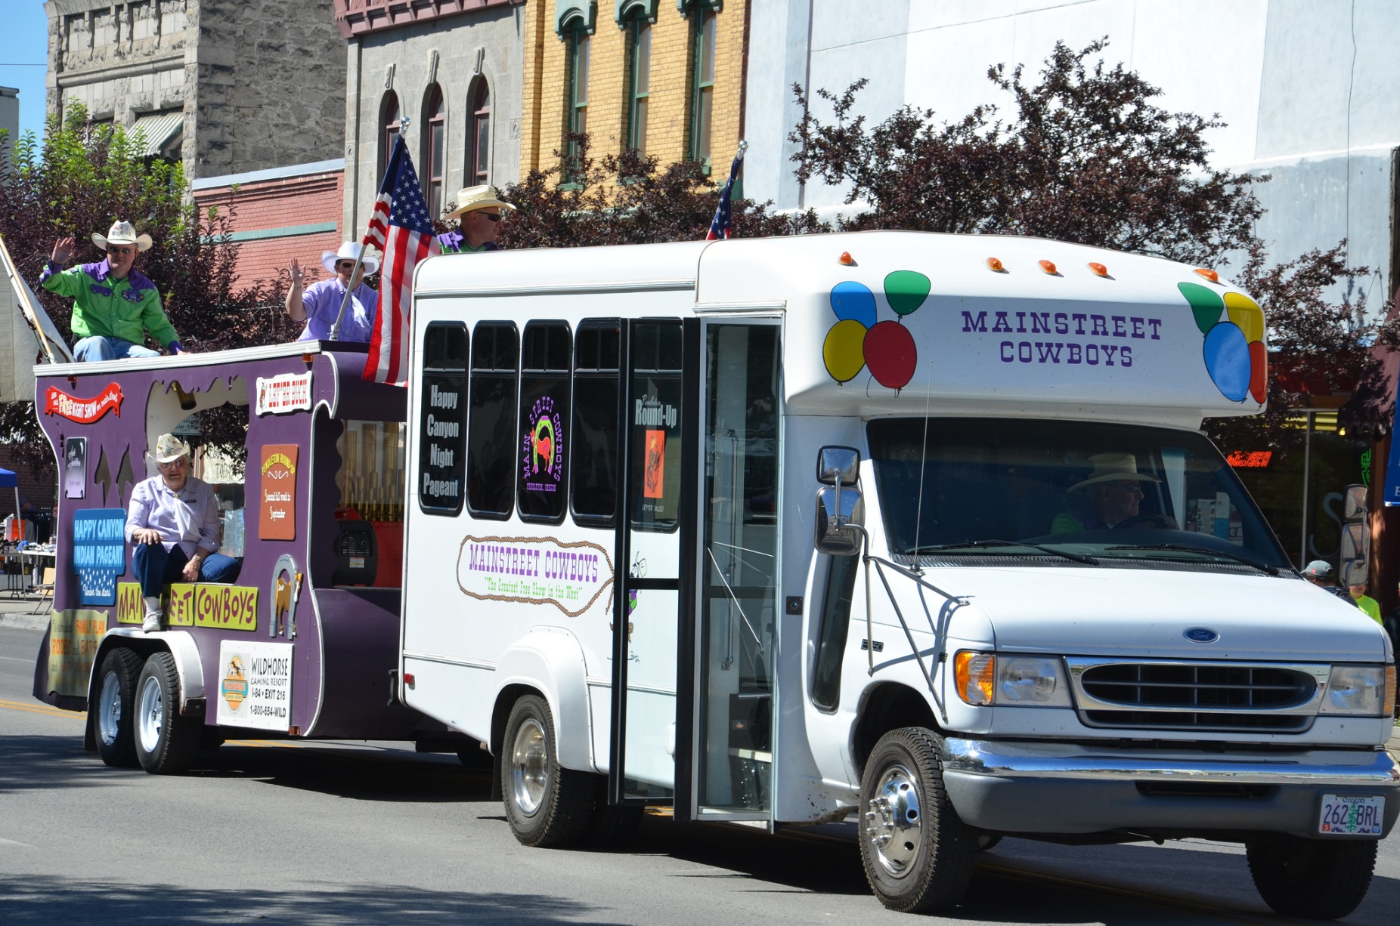
5 Cross promote at similar events with fliers , posters, or a booth

Slide 17
6 10% of marketing each year for new or expanded markets
Event Calendars : Newspapers, Chambers, Oregon Festivals, Travel Oregon related associations and clubs. other...
Facebook promoted posts target geographically and by likes or interests
co-op ads with other events
Radio, what other stations are in that media group

Slide 18
7 Event Refugees
Large successful events sometimes create an exodus of people who aren’t fans of those events.
Rose Festival, Oregon Jamboree, Hells Canyon Motorcycle Rally
Look for opportunities to capture those refugees who might be interested in escaping to your event.
They’re not going to go to a similar event they're looking for something different and with good targeting your event might be that escape

Slide 19
8 Press releases
Send them: When you set dates, when you book performers, when you make changes, whenever you have news to share
Send them to: newspaper, radio, community websites, anyone who is talking about community events
Include photos, links, and COMPLETE contact info

Slide 20
9 Awards and recognition
Look for opportunities to nominate your event
local best of contests, Oregon festivals awards, Travel Oregon industry awards, Oregon Main Street, associations that you belong to, Parade magazine, American Profile, and countless travel websites are always looking for “best of” and top 10 list content

Slide 21
Nominations and awards usually happen in non event season which helps keep people talking about your event year round
You can promote the nomination even if the event doesn't win
The organization giving the awards will also want to promote the winners

Slide 22
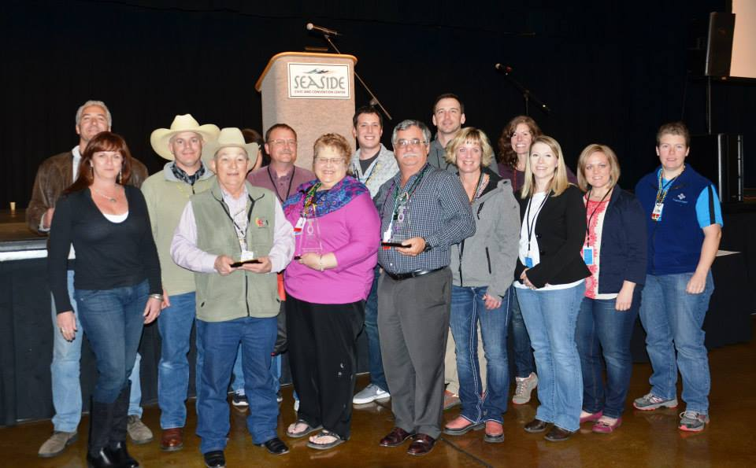
Everyone wants to go to an award winning festival

